Slide 1
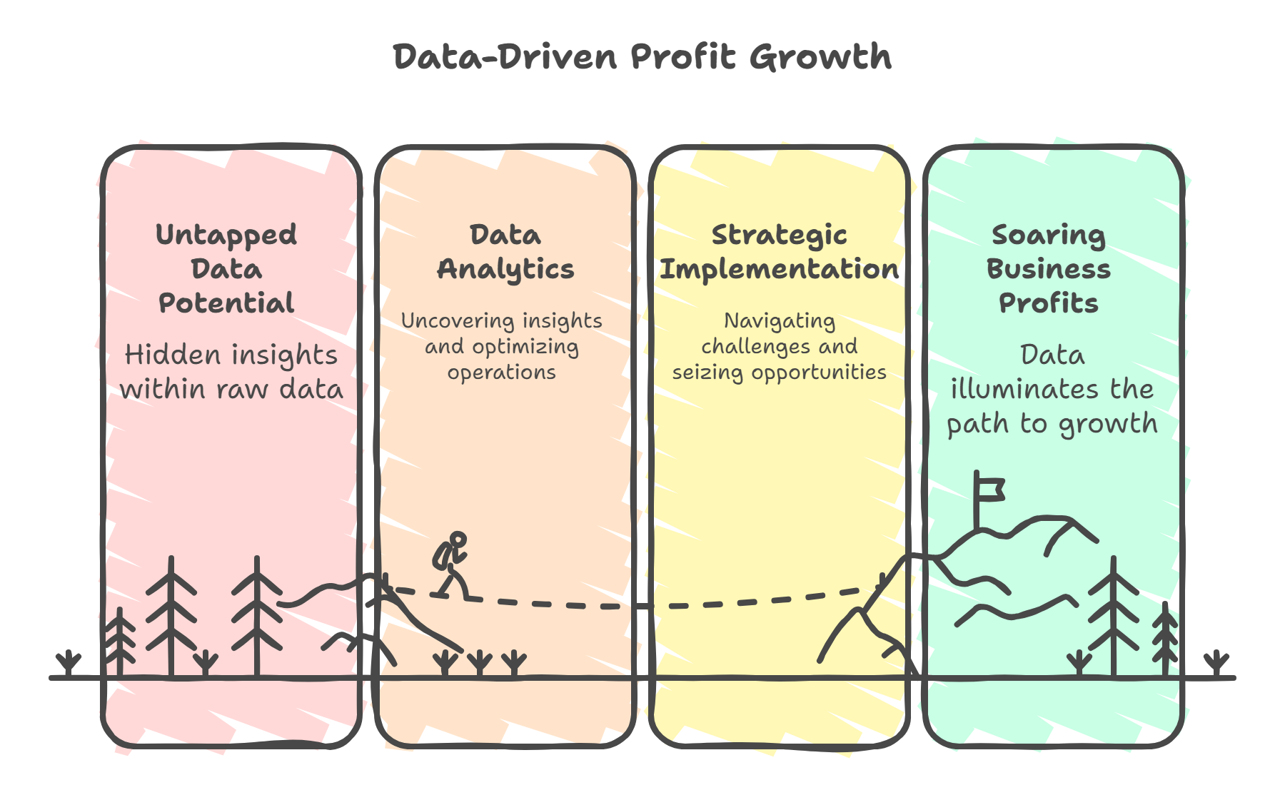
A Tale of Soaring Profits: How Data Lights the Path
Presented by Gajarajan V Y

Slide 2
Executive Summary
Objective: Generate actionable insights to enhance profitability, customer retention, and operational efficiency.
Analytical Approach
Data Cleaning: Multiple Imputation by Chained Equations (MICE) using LightGBM
Sentiment Scoring: Natural Language Processing on customer feedback
Hypothesis Testing: Kruskal–Wallis, Mann–Whitney U, Chi-Square for independence
Statistical Modeling: Linear regression; association strength via Cramér’s V
Multivariate Analysis: Principal Component Analysis (PCA); Multiple Correspondence Analysis (MCA)
Scope of Analysis
Examined ~1,200 bivariate and multivariate variable combinations
Bivariate Findings:
25 significant numerical–numerical relationships
40 significant numerical–categorical relationships
14 significant categorical–categorical relationships
4 significant time–metric relationships
Multivariate Findings: 54 statistically significant patterns

Slide 3
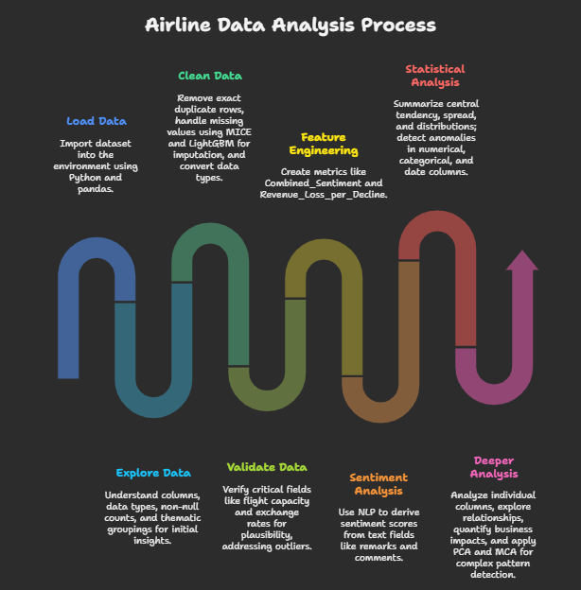

Slide 4
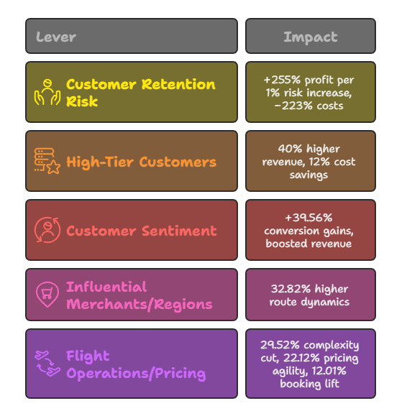
Key Outcomes
Identified the top five insights with the strongest statistical support, practical relevance, and clear interpretability

Slide 5
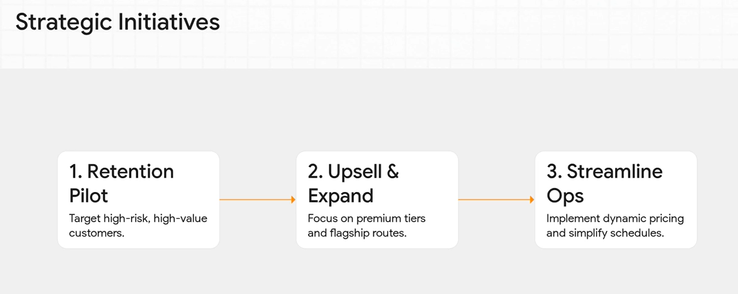

Slide 6
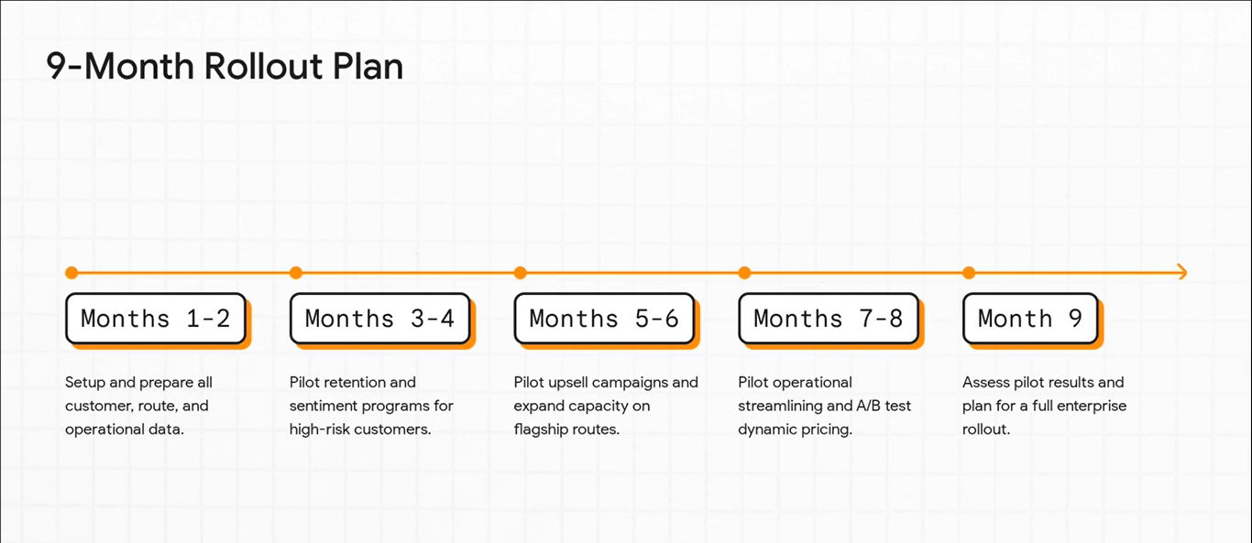

Slide 7
Turning Data into Altitude ( The Story Time )
Imagine charting a course through turbulence—our insights are the stars guiding us from risk to reward, unlocking new layers of profitability and efficiency.
Chapter 1: The Retention Risk Frontier
What
High retention-risk segments correlate with significantly higher profits and lower costs, creating a high-risk, high-reward opportunity
Proof
A 1% increase in retention risk → ~255% higher profitability; ~223% lower costs
Impact (So What)
Targeting high-risk segments can drive massive profit gains and cost reductions
If left unmanaged, these segments risk long-term churn and loss of market share
Next Steps (Now What)
Pilot targeted loyalty and retention programs for high-risk, high-return customers
Measure ROI and churn metrics, then scale the most effective initiatives

Slide 8
Chapter 2: The Golden Tier
What
High-tier customers deliver substantially more revenue and incur lower costs compared to Medium-tier
Low-tier customers generate less revenue while adding higher costs
Proof
Versus Medium-tier:
High-tier → ~40% higher fares, revenue, prices, and taxes; ~12% lower costs
Low-tier → ~48% lower fares and revenue; ~20% higher costs
Impact (So What)
Prioritizing High-tier can boost revenue by ~40% and reduce costs by ~12%
Continuing to serve Low-tier segments at current levels risks eroding overall margins
Next Steps (Now What)
Launch A/B pilots for upselling, premium services, and tailored loyalty programs targeting High-tier customers
Review Low-tier offerings to optimize cost structures or reallocate resources toward higher-value segments

Slide 9
Chapter 3: The High-Value Odyssey
What
Focusing on influential merchants and regions amplifies demand on key routes, creating cascading benefits in global route dynamics and customer preferences
Proof
1% increase in merchant and regional influence → 32.82% higher global route dynamics
1% rise in international travel patterns → 25.86% boost to merchant influence
1% uptick in global route dynamics → 21.42% higher customer location and route preferences
Impact (So What)
Captures 32.82% more demand on flagship routes, driving significant revenue growth and market expansion
Next Steps (Now What)
Expand capacity on high-value corridors (e.g., MEL–LHR, HKG–FRA) to capitalize on surging demand

Slide 10
Chapter 4: The Streamlined Horizon
What
Streamlining flight operations and sentiment management reduces route complexity
Optimizing pricing and discounts enhances revenue and booking dynamics
Proof
1% increase in flight ops and sentiment → 29.52% reduction in route complexity
1% rise in sentiment and currency impact → 22.12% boost in pricing variability
1% lift in discounts → 12.01% increase in revenue and booking dynamics
Impact (So What)
Delivers a 29.52% drop in complexity
Enables 22.12% more pricing agility
Drives a 12.01% uplift in bookings, boosting efficiency and profitability
Next Steps (Now What)
Eliminate unnecessary layovers on high-demand routes
Implement dynamic pricing and discount strategies aligned with real-time sentiment and currency signals

Slide 11
Chapter 5: The Echo of Sentiment
What
Improving customer sentiment drives uplifts in conversion rates, revenue, and overall satisfaction through both direct and indirect effects
Proof
A 1% rise in sentiment and conversion ⇒ 39.56% increase in sentiment dynamics
17.05% of that uplift comes from direct effects; 19.31% comes from indirect effects
Impact (So What)
Up to a 39.56% boost in conversion, revenue, and satisfaction
Strengthens customer loyalty and sharpens our competitive edge
Next Steps (Now What)
Deploy a real-time sentiment analytics dashboard with instant-alert triggers
Monitor feedback dynamically and act within minutes to turn sentiment shifts into business gains

Slide 12
The Flight Path Forward
Implementation Roadmap
Quarter | Initiative
Q4 ’25 | Launch pilot loyalty and retention programs for high-risk, high-return customers
Q1 ’26 | Roll out A/B tests for High-tier upsells and Low-tier cost-optimization
Q2 ’26 | Deploy real-time sentiment analytics platform with instant-alert workflows
Q3 ’26 | Expand capacity on flagship routes (MEL–LHR, HKG–FRA)
Q4 ’26 | Simplify operations—eliminate unnecessary layovers and implement dynamic pricing

Slide 13
Thank You & Full Report
Questions?
Thank you for your time and insights.
Download Full Project Report (21 pages): Detailed Report
Contact
Gajarajan V Y
Email: gajarajan.v2@gmail.com
Phone: +91-9110580190
Linkedin: https://www.linkedin.com/in/gajarajan-v-y/
Github : https://github.com/gaja-123

